Slide 1
The laboratory work 11
Developing android video game part 2

Slide 2
Starting the main activity
We need to hold the start screen for a few seconds and then switch to the main window. The code is written in SplashActivity class.
public class SplashActivity extends AppCompatActivity {
@Override
protected void onCreate(Bundle savedInstanceState) {
super.onCreate(savedInstanceState);
setContentView(R.layout.activity_splash);
Thread thread = new Thread(){
@Override
public void run()
{
try{
sleep(5000);
}
catch (Exception e)
{
e.printStackTrace();
}
finally {
Intent mainIntent = new Intent(SplashActivity.this, MainActivity.class);
startActivity(mainIntent);
}
}
};
thread.start();
}
}

Slide 3
Flying fish
Creating the class FlyingFish
package com.example.thefishgame;
import android.content.Context;
import android.graphics.Bitmap;
import android.graphics.BitmapFactory;
import android.graphics.Canvas;
import android.view.View;
public class flyingFishView extends View {
private Bitmap fish;
public flyingFishView(Context context) {
super(context);
fish = BitmapFactory.decodeResource(getResources(), R.drawable.fish1);
}
@Override
protected void onDraw(Canvas canvas) {
super.onDraw(canvas);
canvas.drawBitmap(fish, 0, 0, null);
}
}

Slide 4
Changing main activity
public class MainActivity extends AppCompatActivity {
private flyingFishView gameView;
@Override
protected void onCreate(Bundle savedInstanceState) {
super.onCreate(savedInstanceState);
gameView = new flyingFishView(this);
setContentView(gameView);
}
}

Slide 5
Changing the flying fish class
public class flyingFishView extends View {
private Bitmap fish;
private Bitmap backgroundImage;
private Paint scorePaint = new Paint();
private Bitmap life[] = new Bitmap[2];
public flyingFishView(Context context) {
super(context);
fish = BitmapFactory.decodeResource(getResources(), R.drawable.fish1);
backgroundImage = BitmapFactory.decodeResource(getResources(), R.drawable.background);
scorePaint.setColor(Color.WHITE);
scorePaint.setTextSize(70);
scorePaint.setTypeface(Typeface.DEFAULT_BOLD);
scorePaint.setAntiAlias(true);
life[0] = BitmapFactory.decodeResource(getResources(), R.drawable.hearts);
life[1] = BitmapFactory.decodeResource(getResources(), R.drawable.heart_grey);
}
@Override
protected void onDraw(Canvas canvas) {
super.onDraw(canvas);
canvas.drawBitmap(backgroundImage, 0, 0, null);
canvas.drawBitmap(fish, 0, 0, null);
canvas.drawText("Score : ", 20, 60, scorePaint);
canvas.drawBitmap(life[0], 580, 35, null);
canvas.drawBitmap(life[0], 680, 35, null);
canvas.drawBitmap(life[0], 780, 35, null);
}
}

Slide 6
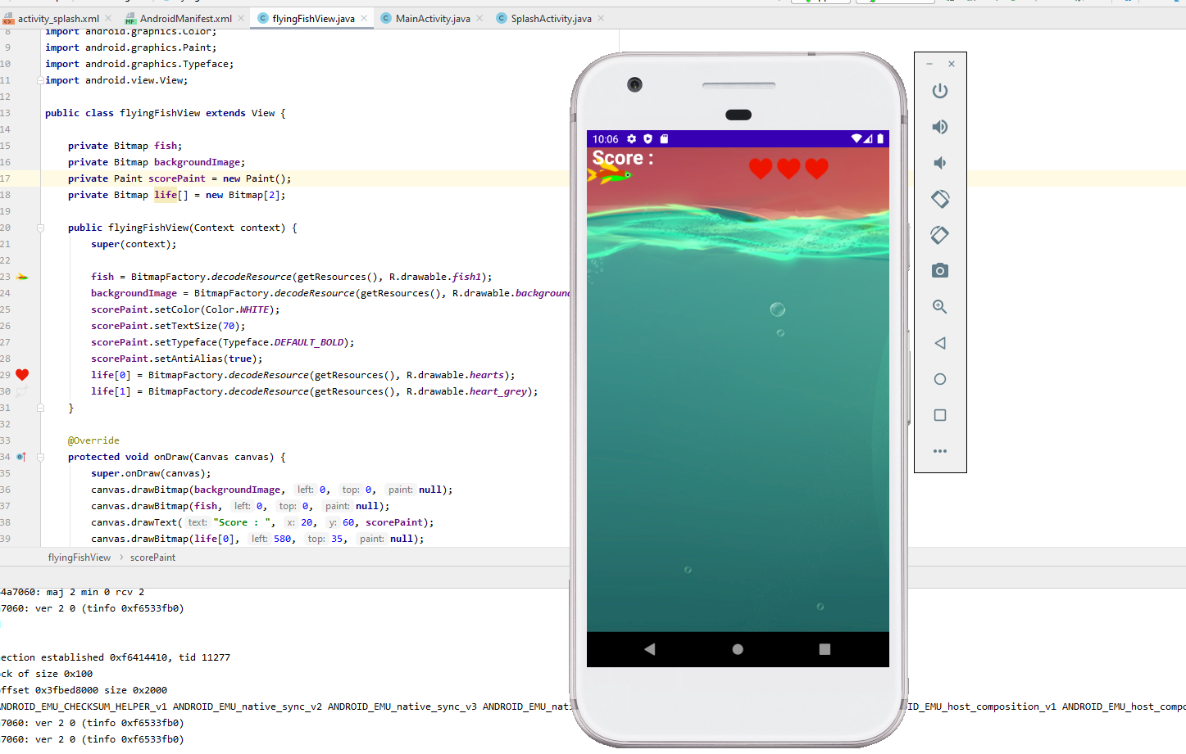
The main window of the game

Slide 7
Assignment
Create a timer of the splash screen holdup;
Put the background and the image of the fish on it;
Set the score and life’s icons.

